Slide 1

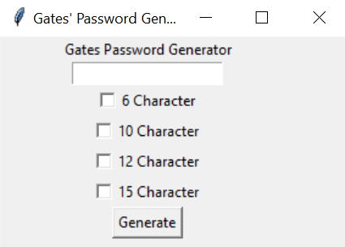
Password Generator
Coders: Gates Ogork
Generate a random password in seconds to be used for various accounts.

Slide 2



WHAT WAS THE IDEA?
The idea was developed because a friend of mine got hacked on all of their social media platforms last year.
They used the same password for all websites, so it was easy once they got into one.
This app generates a simple random password every time.
The passwords is meant to be simple, not too long and easy to remember.

Slide 3
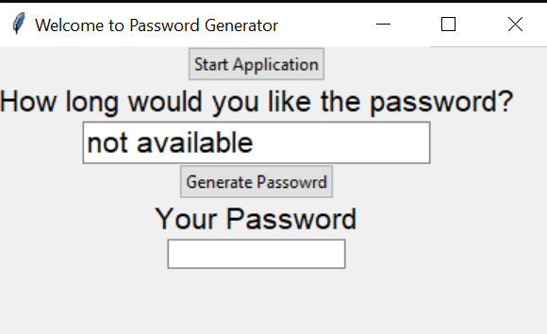
How did the project develop
Gather information about passwords and how strong they have to be.
Do research on the sample codes
Code each part of the app
Combine all the functions
Test the code
https://github.com/ksu-is/Password-Generator-2
https://github.com/ksu-is/PasswordListGenerator

Slide 4
Scope changes and roadblocks
I was surprised at how long it took me to code the entire project
One of the main roadblocks was coding the gui
Halfway through the project I decided to change my whole code script.
I decided on this changed because it makes the app look better in general
Another roadblock was creating strong passwords and reliable.
I overcame these challenges by watching tutorials on YouTube and asking for help from friends.

Slide 5
Run the code
Does it run? Yes and no
What would I do next? If I had more time, I would make the gui work
Play code video

Slide 6
conclusion
If I had more time I would make my gui better
I would reach out to a classmate who’s presentation I saw and work with him on making my code better.
This project was very insightful for me. I got to experience real life coding challenges and roadblocks.

